Slide 1
Data Science Infrastructure
Medial EarlySign

Slide 2
Birdseye Overview
Data Repository
Unification
Performance
Training Infrastructure
Deal with time dimension
Unification
Matrix Generation
Training and Analysis
Production Infrastructure
AlgoMarkers
Easy productization
On prem Sandboxes
Software wrappers
ToolSet
Efficiency

Slide 3
Data and Data Repositories

Slide 4
Typical Medical Record
Demographics
Lab Tests
Diagnosis
Drugs
Procedures
Admissions
Textual Summaries

Slide 5
Data Repository – Major Needs
Unified Data Model
Memory Efficient
Quick queries of:
Get all events of a signal for a certain patient sorted by time
Unified API to use data

Slide 6
Data Repository – Data Model
Each signal can have:
0 , 1, 2 or more Time Channels
0 , 1, or more Value Channels
Each Value Channel is one of:
Numerical
Categorial
Examples:
GENDER :
0 time channels
1 Value Channel, Categorial (Male/Female)
Hemoglobin :
1 time channel (date of test)
1 value channel (Numerical)
Drugs :
1 time channel (date of prescription)
2 value channels: categorial (drug full name), numerical (for how long in days)

Slide 7
Data Repository – Dictionaries & Hierarchies
Example: Drugs
Can be a 100K or more different options (different names, dosages, etc)
Signal has a dictionary mapping numbers to the actual strings
Data repository saves the numbers – saving the space
APIs allow getting the names quickly given the numbers
Dictionaries can have new values defined, and become sets.
Sets can contain other elements in the dictionary (even other sets)
Example: ATC codes (example ATC_A10 : all diabetes drugs)
APIs allow efficient querying using sets:
Is a value contained in a set
Find all cases in which there was a value contained in a set, etc

Slide 8
Data Repository - Implementation
InfraMed:
Large C++ library to handle:
Loading of new repositories
Loading of data to an existing repository
Reading all or a subset of the data into memory (only the needed patients, only the needed signals)
Extremely fast get(pid, signal) – the most useful query.
Unified APIs to get time or value channels
APIs for dictionaries usage : querying, translating, hierarchies.
Python APIs wrapping the c++ API.
Real Life experience:
Extremely fast – enabler. Working with SQL databases can be >100x slower.
Works well on strong machines, don’t even need a large cluster:
A strong server with >64GB RAM and >8 cores is already giving good results.

Slide 9
Data Repository
A unified data model
Extremely fast in pulling data for training/testing
Full APIs to build and use such repositories:
MedRepository library : c++ based
Able to hold huge amounts of data in RAM, in a way that minimized cpu caching.
Tools on top to use it, to build such repositories, and to use them for training & testing
Python APIs as well
Ability to create repositories “on the fly” given injected data: this is what we use when applying a model in real time AlgoAnalyzer environment.
Dealing with different types of signals
Numerical (Labs)
Categorical (Diagnoses, Drugs, Admissions, Procedures)
General Signal Model:
Several Channels of time (usually 1, sometimes 2 when there’s a range of time)
Several Channels of values (value of a lab test, or 2 values (BP), or more (drug prescription), etc)
Categorical Signals:
Contain Dictionaries defining the categorical options
A dictionary can contain “Sets” of some of the categories ( a hierarchy)
Example: All Drugs and ATC codes.
Extensive tools to quickly find if a category set was used, etc.

Slide 10
Data Repository Process and Advantages
Building Process:
Normalize all data to the same names & units
Prepare dictionaries for categorical signals (ATC, ICD9, ICD10)
Load into Repository
Automatic tools for QA & testing of quality.
Main Advantage over typical SQL databases:
100x faster in reading and querying data for ML training and testing.
Optimized queries on top: for time queries, for categorical queries.
Ultra efficient c++ API on top to enable very efficient (and thin) powerful tools on top (train, test, query, use as product, viewers, etc)
A unified data model:
Test transferability of models to different data sets
Use different data sets in training
Ability to develop complex tools that can be used in a general way on a huge set of problems.
Ability to apply in field models that were developed.

Slide 11
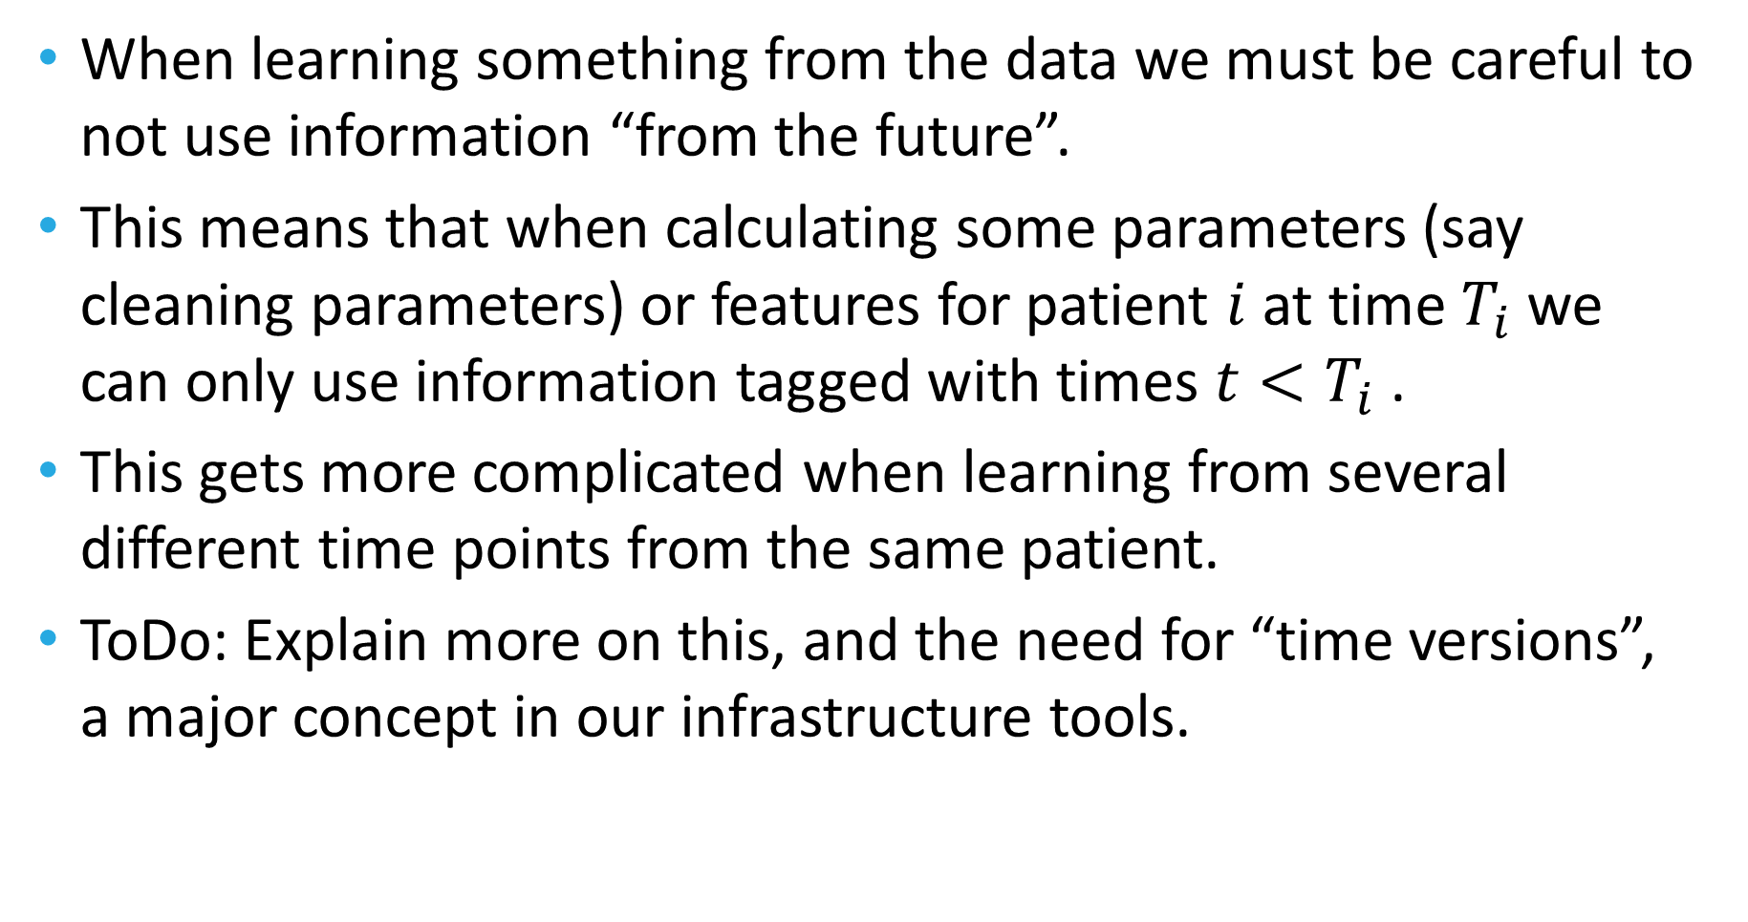
The time problem: preventing leaks
When learning something from the data we must be careful to not use information “from the future”.
This means that when calculating some parameters (say cleaning parameters) or features for patient $i$ at time $T_{i}$ we can only use information tagged with times $t<T_{i}$ .
This gets more complicated when learning from several different time points from the same patient.
ToDo: Explain more on this, and the need for “time versions”, a major concept in our infrastructure tools.

Slide 12
The path a record goes through
Rep processors
Actions that can change the record (next slide with examples)
Create online virtual signals to help generate complex features later
Feature Generators
From simple to very complex
Feature Processors
Operations over the generated features (imputing, normalizing, selection, etc)
Matrix generation
Model training/testing
Many options for modelling (Linear, svm, RF, Boosted trees, Neural Nets)
Post Processors
Calibration
But Why : explain the results
As a product: AlgoMarker API – to report back results to AlgoAnalyzer.

Slide 13
Rep Processors
All working with efficient time-versioning to enable maximal efficiency while doing the right thing.
Cleaners:
Pre configured
Rule based
Learning the distribution
Neighbor cleaning
Check requirements
Is sample eligible to participate in learning/testing/production time usage.
Virtual Signals
Registries for major diseases (Diabetes, CKD, CVD, HyperTension, Cancer, etc)
Calculated signals
Apply some functional on signal
Combine several signals into one
Select subgroups of categorical signals
Use conditions on one signal to select another
Completers/Imputers
Learn models to estimate the value for a signal at a specific time point it is missing
Note: This is learning a model inside a model classical example.
Use other learned models to create a new signal

Slide 14
Feature Generators
Functionals on a time window:
Last, Average, Mean, Max, Min, Median, Slope, Delta, …
Over a chosen time frame relative to the selected time point.
Categorical features:
Category set within a time window:
Appearing or not
Counts
Scan all or a subgroup of all sets and choose those correlated with the outcome (ability to test information gain over age+gender or any other stratification).
Use Deep Learning embedding of a large dimension into lower dimensions
Predicted values of signals at a certain time point (a model within a model)
Specific areas:
Demographic features
Smoking Features
Alcohol usage features
Drug intake features
Drug effectiveness features

Slide 15
Feature Processors
Cleaners : throw out features that are outliers
Imputers
Using stratification
By age, gender
By other signals (example by last Glucose level)
Iterative:
Iterations of predicting the missing values using the previous iteration imputations, converging to a solution.
Using GANs (deep learning)
Add features that are combinations of already created features
Open categorical features to “one hot”
Feature selection:
Univariate stratified correlation
MRMR
Lasso
Feature importance
Iterative – bottom up, top down : heavy in computation.
Manual: only named features. Using names, or the “tagging” mechanism.
Add PCA features

Slide 16
Modeling
Can control all the models parameters
Linear Models
All sorts of regularizations: Ridge, Lasso
Degree of polynomials
Random Forest variants
Boosted tree variants
In particular also LightGBM and XGBoost
Neural Nets
Export Learning to TensorFlow and pull back model inside (no need of TensorFlow package when applying model)

Slide 17
Post Processors
Calibration
On a given calibration learning set
Equal size bins
Equal cases bins
Isotonic calibration
ButWhy
Individual strength of each feature in prediction.
Aggregation over signals/groups of features.
Using Shapeley methodology variants.
Sometimes requires complex training in order to work properly.

Slide 18
Serialization
It is extremely important to be able to save all the complex paths a model needs to go through in order to get a prediction.
This means keeping all the Signals lists, Rep Processors, Feature Generators, Feature Processors, Model, and Post processors used and all their parameters.
Our serialization is able to keep all of this into one single file (!), and open it for further training, or for applying for testing or in the field.
Serialization process is complex as it allows for backward computability even when objects are changed and added.

Slide 19
Analysis
Analyzing results can be a very hard task
The bootstrap package developed internally allows for all analysis options:
Calculate all performance params: AUC, Sens, Spec, PPV, PR, all at all needed points.
Bootstrap and calculate confidence interval for results.
Survival analysis: KM curves
Estimate incidence, or use external given incidences
Do the right thing with outcomes and time windows
Sometimes the same sample is a case or control depending on the time window tested.

Slide 20
AlgoMarker API
A wrapper library allowing the usage of models in field with the AlgoAnalyzer.
Gets the serialized model file
API – to load AlgoMarker
API – to push data into a virtual in-mem repository (and clean it after usage)
API – to use model on data and get back scores (raw or calibrated), eligibility information, error information, and ButWhy information.
Heavily tested, stabilized, efficient
Uses the EXACT model created in the training (the exact serialized file).

Slide 21
Additional matters
Large set of tools to wrap all the previously described capabilities:
Build repositories
Train models
Test models
Export models
Print models
Get Matrices
Graphical viewers for patients
More…
Configurable !!!! :
To train a new model, no need to write code
A simple Json format configuration file defines ALL the stages selected for the model
Unifying the whole process of ML on medical records to one paradigm.
Performance:
extremely efficient in memory usage
Parallelization (!!!) – maximal.
Handling learning in CV effortlessly
C++ and Python tools and APIs
Effortless porting to AlgoAnalyzer
Ability to handle all sorts of ML problems:
Binary predictions
Multi Category predictions
Regression predictions
Huge amount of code invested underneath.

Slide 22
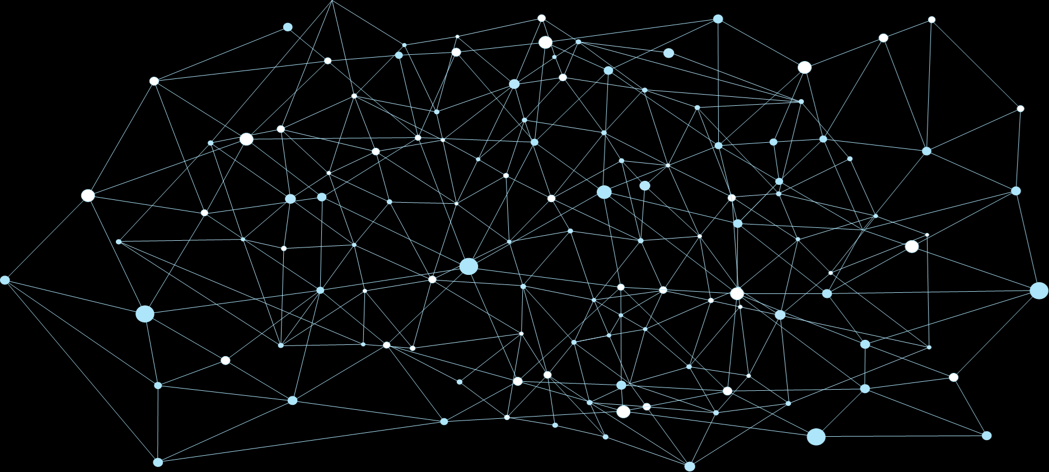
Typical Medical Record
Demographics
Lab Tests
Diagnosis
Drugs
Procedures
Textual Summaries

Slide 23
Training Infrastructure
Unified
Libraries
ToolSets
APIs
Configurable
Matrices, & Models
Cleaners
Feature Generators
Imputers
ML modeling
Analysis
Bootstrapping
External Validation
Efficiency
Parallelism

Slide 24
Training Infrastructure
Data Repository
Cleaning
Feature Generation
Imputation
Modeling
Validation
Prepare Matrix For Modeling

Slide 25
Feature Generation – simple features
Data Repository
Basic Cleaning
Feature Generation
Imputation
Modeling
Validation
Lab Tests are not in uniform sizes
Different number of tests per patient
Different times
Learn/Predict Matrix has to be of a fixed size
… | Slope | Avg | Max | Last
… | Slope | Avg | Max | Last

Slide 26
Feature Generation – modeled features
Data Repository
Basic Cleaning
Feature Generation
Imputation
Modeling
Validation
Train Models to Predict:
Future Values of test
Past Values of test
Using only this lab test, or also combining others
?
?

Slide 27
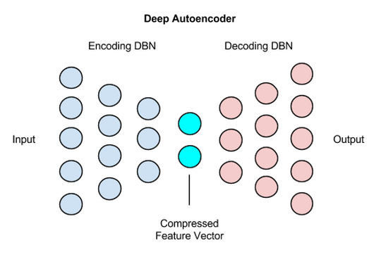
Feature Generation – Autoencoder Features
Data Repository
Basic Cleaning
Feature Generation
Imputation
Modeling
Validation
Step1:
Generate a feature matrix using previous methods.
Step2:
Train an autoencoder on matrix
Additional Flavor:
Train the autoencoder on features 1 year ahead
Add Layer to Features
OR
Use Layer as Features

Slide 28
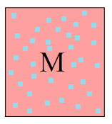
Feature Matrix Imputation
Data Repository
Basic Cleaning
Feature Generation
Imputation
Modeling
Validation
At this stage we got a matrix of the current features:
Rows : a row for each patient id + time point participating
Columns: the different features created so far
There are typically many missing values
In many cases (Neural Nets for example) a complete matrix is needed for the Modeling stage
M0
Initial Imputing
Based on age and gender statistics
M0
Train model on non
Imputed points to predict value
M1
Use model to predict imputed points
Repeat training for
several cycles
Regression Models
Trees
NN

Slide 29
Actual Classifier - Finally
Data Repository
Basic Cleaning
Feature Generation
Imputation
Modeling
Validation
1.2
Many Options
Typically Best Results are with:
Random Forest Variants
Gradient Boosting (typically with regression trees)
Neural Nets (typically fully connected 2-4 layers)
1
0.8
0.6
0.4
0.2
0
-0.2
-1.5
-1
-0.5
0
0.5
1
So Far – results from these different methods are more or less at the same performance in medical records problems
Open Deep Learning Problem: Find an information extractor “like CNNs” for Medical Records problems

Slide 30
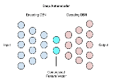
The Journey
Data Repository
Basic Cleaning
Feature Generation
Imputation
Modeling
Validation
RF
Bootstrap
Analysis
GBM
Bootstrap
Analysis
NN
Bootstrap
Analysis
Stack
Bootstrap
Analysis

Slide 31
Moving To Infrastructure & Productization
A unified language to define and work with problems.
Raw Data
Semi Automated
Repository
Optional
Modeling
& Testing
Export as AlgoMarker
Cohort
Train/Test Lists
Configure:
Cleaning
Features
Selection
Normalization
Model
Sampling
Filtering
Matching
Splitting

Slide 32
Internal or External Sandboxes
Internal
External
Data Center
20M+ records
100M+ patient years
Data Server
Client Data
Computing Cluster
Computing Server
Installed with Medial Tools
Repository/Training/Testing/Exporting
Secured
Secured Access

Slide 33
Transfer Learning
Internal
External
+
Model
Scores
Client Data
Features
Model
Retrained
Model
Trained on internal Data
Biological
No “client specific” features
Trained on large datasets
Uses the power of the Internal model
Incorporates client specific data to improve performance

